Slide 1
Induction and Inductance
Session 10-11
SCIE6063
COMPUTATIONAL PHYSICS
June 2024

Slide 2
These slides have been adapted from
Halliday D.; Resnick R. and Walker J. (2018). Fundamentals Of Physics ,Extended,
11th , John Wiley & SONS Inc, New York, ISBN: 9781119306856
Chapter 30

Slide 3
2. Faraday's Law of Induction
The magnitude of the emf induced in a conducting
loop is equal to the rate at which the magnetic flux
through that loop changes with time.
If we change the magnetic flux through a coil of N turns, an induced emf appears in every turn and the total emf induced in the coil is the sum of these individual induced emfs.

Slide 9
Lenz's Law
An induced current has a direction such that the magnetic field due to the current opposes the change in the magnetic flux that induces the current.

Slide 10
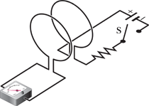
Fig.3. A Conductor moving in the magnetic field
The number of magnetic field lines that pass through the loop is changing.
Closing the switch S causes a current in the left-hand loop.
Fig.4. An ammeter registers a current in the left hand wire loop just as switch S is closed or opened. No motion of the coils is involved.

Slide 11
The current in the coil induced by a changing magnetic field or changing the area of a coil methods is called an induced current. A closed circuit is necessary for the induced current to flow.
The emf produced in the coil which drives the induced current is called the "induced emf". The induced emf exists whether or not the coil is part of a closed circuit.
The phenomenon of producing an induced emf with the aid of a magnetic field is called electromagnetic induction.

Slide 12
What is the cause of induced emf?
The number of magnetic field lines that pass through the loop is changing.
The faster the number of magnetic field lines that pass through the loop changes, the greater the induced emf

Slide 13
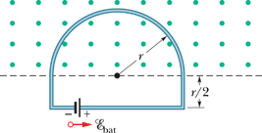
Example Problem
The Figure shows a conducting loop consisting of a Half-
circle of radius r=0.20m and three straight sections. The
half-circle lies in a uniform magnetic field that is directed out
of the page; the field magnitude is given by B=4.0t²+2.0t+3.0,
with B in teslas and t in seconds. An ideal battery with emf
ε_{bet}=2.0V is connected to the loop. The resistance of the loop
is 2.0Ω.
What are the magnitude and direction of the emf induced
around the loop by B field at t=10 s?
(b) What is the current in the loop at t= 10 s?
Fig.6. A battery is connected to a conducting
loop that includes a half-circle of radius r
lying in uniform magnetic field. The field is directed out the page; its magnitude changing.

Slide 16
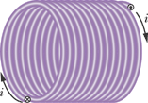
4. Inductors and Inductance
consider a long solenoid (more specifically, a short length near the middle of a long solenoid) as our basic type of inductor (symbol ) to produce a desired magnetic field
The inductance of the inductor is
Fig.7. An inductor
Unit is: 1 henry = 1 H= 1T.m²/A

Slide 17


Inductance of a solenoid:

Slide 18
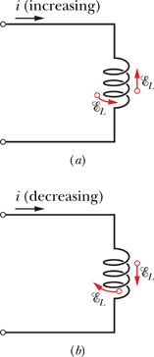
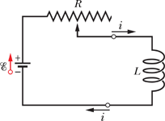
Self-Induction
Fig.8. If the current in a coil is changed by varying contact position on a variable resistor, a self –induced emf ε_{L} will appear in the coil while the current is changing.
This process is called self-induction, and the emf that appears is called a self-induced emf.

Slide 19
An induced emf ε_{L} appears in any coil in which the current is changing.

Slide 20
5. RL Circuits,
a
b
S
R
ε
VL
L
Solution this equation :
Fig.9. An RL circuit . When switch S is closed on a, the current rises and approaches a limiting value .
Which we can rewrite as :
=L/R , the inductive time constant

Slide 21
RL Circuit – current decay.
If the switch S is closed on a along enough for the
equilibrium current ε/R to be established and the is
thrown to b, the effect will be to remove the battery from
the circuit.
+
-
The solution this differential equation that satisfies the initial condition i(0)= i₀ = ε/R is :
(decay current)

Slide 22
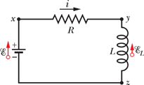
6. Energy Stored in a Magnetic Field
The left side of Eq. represents the rate
at which the emf device delivers
energy to the rest of the circuit.
The rightmost term represents the rate
at which energy appears as thermal
energy in the resistor.
Energy that is delivered to the circuit
but does not appear as thermal energy
must, by the conservation-of-energy,
be stored in the magnetic field of the
inductor.
Fig.10. An RL circuit of Fig.9, with the switch closed on a.

Slide 23


Slide 24


Energy Density of a Magnetic Field
Consider a length l near the middle of a long solenoid of cross-sectional area A carrying current i; the volume associated with this length is Al.
The energy stored per unit volume of the field is
Fig.11. Solenoid

Slide 25
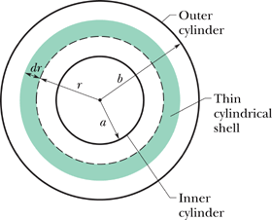
Sample Problem
A long coaxial cable consists of two thin-walled concentric conducting cylinders with radii a and b.
The inner cylinder carries a steady current i, and the outer cylinder provides the return path for that current.
The current sets up a magnetic field between the two cylinders.
(a) Calculate the energy stored in the magnetic field for a length ℓ of the cable.
(b) What is the stored energy per unit length of the cable if a=1.2mm, b=3.5mm , and i=2.7A ?
Fig.12. A coaxial cable consists of two thin-walled concentric conducting cylinders with radii a and b.

Slide 26
Assignment
Do the problems in the text-book: Fundamental of Physics, Chapter 30 (Induction and inductance) ; p.895-902.
Problems Number: 3, 29, 34, 47, 61, 67, and 72

